Slide 1
Operations Scheduling

Slide 2
Production Planning Process
Process Planning
Long
Range
Strategic Capacity Planning
Medium
How much & when
to produce
Aggregate Planning
Range
Manufacturing
Services
Master Production Scheduling
How much & when
to produce the end item
How much & when
to produce component items
Material Requirements Planning
Order Scheduling
Weekly Workforce &
Customer Scheduling
Short
Range
Daily Workforce &
Customer Scheduling

Slide 3
Outline
Scheduling
  What is it?
  Scheduling involves fixing the priorities for different jobs and deciding the starting and finishing time (or date) of each job. It specifies when resources are needed to produce a product or provide a service.
  Objectives
  Sequencing rules
    Single resource

Slide 4
Scheduling
Deals with the timing of operations
Specifies when resources are needed to produce a product or provide a service
Helps us decide what order to perform jobs
All organizations perform scheduling to some extent…

Slide 5






In service organizations, managers schedule…
Nursing staff
Operating room use
Classroom use
Instructor schedules

Slide 6
In manufacturing organizations, managers schedule…
Workers
Purchases of materials
Easier to schedule here
Production of goods
…
Sort
Wash
Dry
Iron
Grinding
Forging
Lathes
Painting
Welding
Drills
Milling
Office
machines
Foundry
Harder to schedule here

Slide 7
Sequencing Rules
Determine the order of jobs that are being processed
  Which job should a machine do first, next, etc.?
  Which surgeries should go to the operating room first?
  What order should you work on your course projects in?
Many sequencing rules exist
Each attempts to achieve to an objective

Slide 8
Objectives in Scheduling
Meet customer due dates
Minimize job lateness
Minimize response time
Minimize completion time
Minimize time in the system
Minimize overtime
Maximize machine or labor utilization
Minimize idle time
Minimize work-in-process inventory

Slide 9
Types of Sequencing Rules
Sequencing jobs at a single resource
Sequencing jobs across multiple resources

Slide 10
Sequencing Rules (Single Resource)
Local
  First Come First Served
  Last Come First Served
  Shortest Processing Time
  Longest Processing Time
  Earliest Due Date
Global
  Slack Per Remaining Operation
  Critical Ratio
- consider only current work center operation
consider current and all subsequent work
center operations needed to complete job

Slide 11
Sequencing Rules (Single Resource)
Local
  First Come First Served
  Last Come First Served
  Shortest Processing Time
  Longest Processing Time
  Earliest Due Date
Global
  Slack Per Remaining Operation
  Critical Ratio

Slide 12
Sequencing Example
This semester you took 5 classes
Each has a major project due at some point in the semester
Projects are assigned during the first week of the semester
On the first day
You are given your English assignment
Next,
You are given an Accounting assignment…
Processing time:
9
3
8
2
6
Time until due:
23
15
18
6
8
Marketing
Finance
English
Management
Accounting

Slide 13
Sequencing Example
This semester you took 5 classes
Each has a major project due at some point in the semester
Projects are assigned during the first week of the semester
What order
do you work on the projects?
Processing time:
9
3
8
2
6
Time until due:
23
15
18
6
8
Marketing
Finance
English
Management
Accounting

Slide 14
First Come First Served (FCFS)
Jobs are processed in order of arrival
Which comes first?
What order
do you work on the projects?
Processing time:
9
3
8
2
6
Time until due:
23
15
18
6
8
Marketing
Finance
English
Management
Accounting

Slide 15
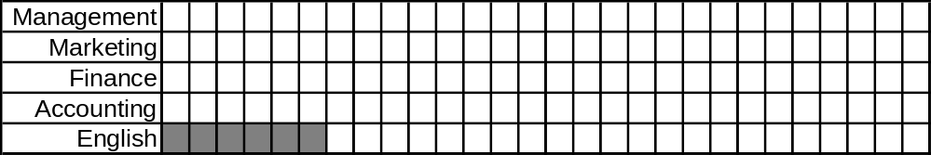

First Come First Served (FCFS)
Processing time:
9
3
8
2
6
Time until due:
23
15
18
6
8
Marketing
Finance
English
Management
Accounting

Slide 16
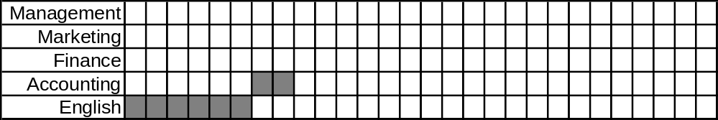
First Come First Served (FCFS)
Processing time:
9
3
8
2
6
Time until due:
23
15
18
6
8
Marketing
Finance
Management
Accounting

Slide 17
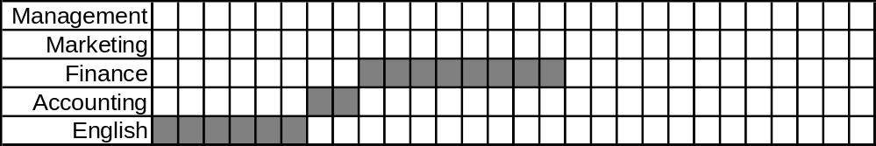
First Come First Served (FCFS)
Processing time:
9
3
8
2
6
Time until due:
23
15
18
6
8
Marketing
Finance
Management

Slide 18
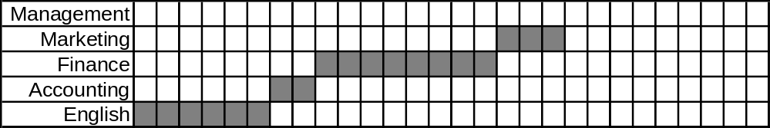
First Come First Served (FCFS)
Processing time:
9
3
8
2
6
Time until due:
23
15
18
6
8
Marketing
Management

Slide 19
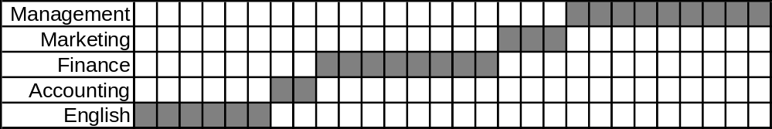
First Come First Served (FCFS)
Superimposing
due dates…
Processing time:
9
3
8
2
6
Time until due:
23
15
18
6
8
Marketing
Finance
English
Management
Accounting
Management

Slide 20
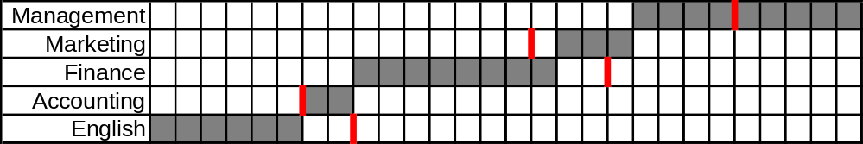
First Come First Served (FCFS)
Superimposing
due dates…
So 3 projects are late!!
How many weeks late?
Processing time:
9
3
8
2
6
Time until due:
23
15
18
6
8
Marketing
Finance
English
Management
Accounting

Slide 21
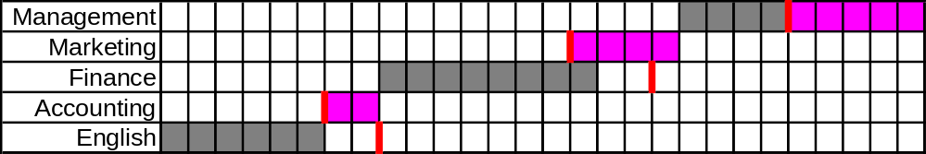
First Come First Served (FCFS)
Superimposing
due dates…
So 3 projects are late!!
How many weeks late?
Processing time:
9
3
8
2
6
Time until due:
23
15
18
6
8
Marketing
Finance
English
Management
Accounting

Slide 22
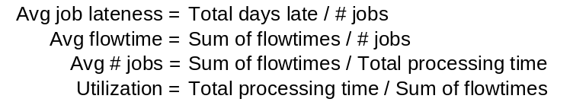
First Come First Served (FCFS)
Total days late
Number of jobs
11
5
Avg. job lateness =
=
= 2.2 days
Processing time:
9
3
8
2
6
Time until due:
23
15
18
6
8
Marketing
Finance
English
Management
Accounting

Slide 23
First Come First Served (FCFS)
Makespan:
total time to process all jobs
= 28 days
Flow time:
Sum of times each job spends in waiting, and
being processed
Processing time:
9
3
8
2
6
Time until due:
23
15
18
6
8
Marketing
Finance
English
Management
Accounting

Slide 24
First Come First Served (FCFS)
Makespan
= 28 days
Flow time =
6
+
+
+
+
8
16
19
28
= 77
Processing time:
9
3
8
2
6
Time until due:
23
15
18
6
8
Marketing
Finance
English
Management
Accounting

Slide 25
First Come First Served (FCFS)
Makespan
= 28 days
Flow time =
= 77
Average flow time =
Sum of flow times / # jobs
Processing time:
9
3
8
2
6
Time until due:
23
15
18
6
8
Marketing
Finance
English
Management
Accounting

Slide 26
First Come First Served (FCFS)
Makespan
= 28 days
Flow time =
= 77
Average flow time =
77 days/5 jobs
= 15.4 days/job
Processing time:
9
3
8
2
6
Time until due:
23
15
18
6
8
Marketing
Finance
English
Management
Accounting

Slide 27
First Come First Served (FCFS)
Makespan
= 28 days
Flow time =
= 77
Average flow time =
= 15.4 days/job
Avg # jobs in system =
Sum of flow times / total processing time
Processing time:
9
3
8
2
6
Time until due:
23
15
18
6
8
Marketing
Finance
English
Management
Accounting

Slide 28
First Come First Served (FCFS)
Makespan
= 28 days
Flow time =
= 77
Average flow time =
= 15.4 days/job
Avg # jobs in system =
77 days/28 days
= 2.75
Utilization =
Total processing time / sum of flow time
Processing time:
9
3
8
2
6
Time until due:
23
15
18
6
8
Marketing
Finance
English
Management
Accounting

Slide 29
First Come First Served (FCFS)
Makespan
= 28 days
Flow time =
= 77
Average flow time =
= 15.4 days/job
Avg # jobs in system =
77 days/28 days
= 2.75
Utilization =
28 days/77 days
= 36.4%
Processing time:
9
3
8
2
6
Time until due:
23
15
18
6
8
Marketing
Finance
English
Management
Accounting

Slide 30
Sequencing Rules (Single Resource)
Local
  First Come First Served
  Last Come First Served
  Shortest Processing Time
  Longest Processing Time
  Earliest Due Date
Global
  Slack Per Remaining Operation
  Critical Ratio

Slide 31
Last Come First Served (LCFS)
As jobs pile up the operator picks the
one on the top of the stack to work on
Processing time:
9
3
8
2
6
Time until due:
23
15
18
6
8
Marketing
Finance
English
Management
Accounting

Slide 32
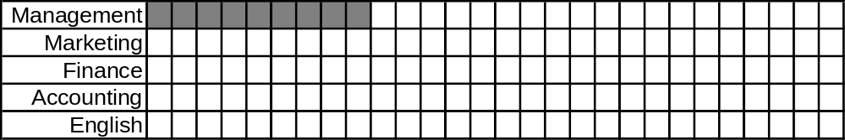
Last Come First Served (LCFS)
Processing time:
9
3
8
2
6
Time until due:
23
15
18
6
8
Marketing
Finance
English
Management
Accounting

Slide 33
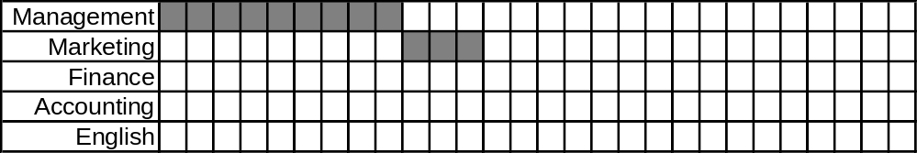
Last Come First Served (LCFS)
Processing time:
9
3
8
2
6
Time until due:
23
15
18
6
8
Marketing
Finance
English
Accounting

Slide 34
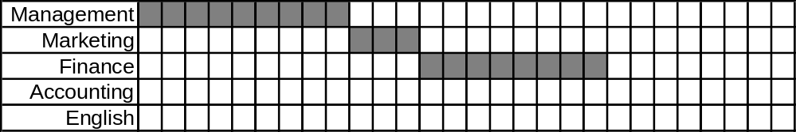
Last Come First Served (LCFS)
Processing time:
9
3
8
2
6
Time until due:
23
15
18
6
8
Finance
English
Accounting

Slide 35
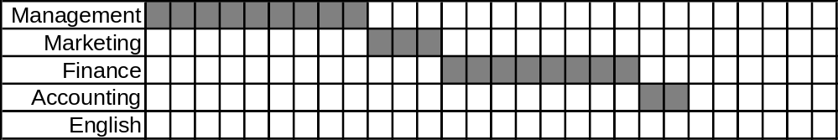
Last Come First Served (LCFS)
Processing time:
9
3
8
2
6
Time until due:
23
15
18
6
8
English
Accounting

Slide 36
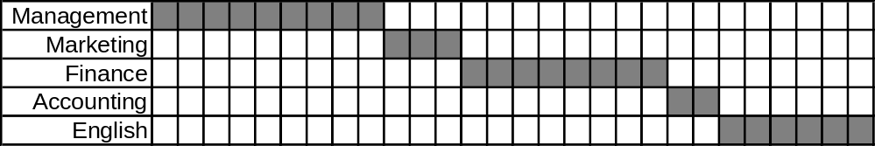
Last Come First Served (LCFS)
Superimposing
due dates…
Processing time:
9
3
8
2
6
Time until due:
23
15
18
6
8
English

Slide 37
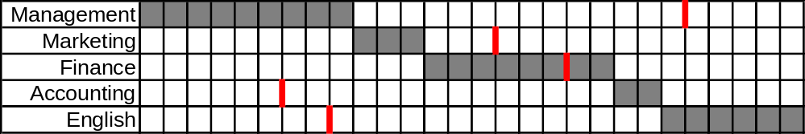
Last Come First Served (LCFS)
Superimposing
due dates…
So 3 projects are late!!
Processing time:
9
3
8
2
6
Time until due:
23
15
18
6
8

Slide 38
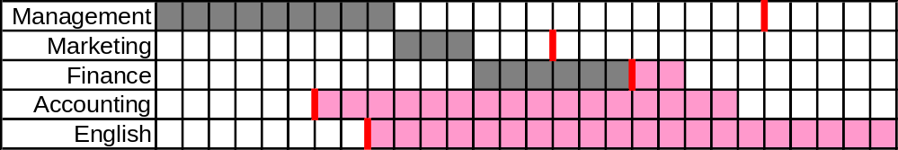
Last Come First Served (LCFS)
Superimposing
due dates…
Total days late
Number of jobs
38
5
Avg. job lateness =
=
= 7.6 days
Processing time:
9
3
8
2
6
Time until due:
23
15
18
6
8

Slide 39
Last Come First Served (LCFS)
Superimposing
due dates…
Makespan =
28 days
Flow time =
9
+
12
+
20
+
+
22
28
= 91
Average flow time =
91 days/5 jobs
= 18.2 days/job
Avg # jobs in system =
91 days/28 days
= 3.25
Utilization =
28 days/91 days
= 30.8%
Processing time:
9
3
8
2
6
Time until due:
23
15
18
6
8

Slide 40
Sequencing Rules (Single Resource)
Local
  First Come First Served
  Last Come First Served
  Shortest Processing Time
  Longest Processing Time
  Earliest Due Date
Global
  Slack Per Remaining Operation
  Critical Ratio

Slide 41
Shortest Processing Time (SPT)
Process the job with the shortest
processing time first
Processing time:
9
3
8
2
6
Time until due:
23
15
18
6
8
Marketing
Finance
English
Management
Accounting

Slide 42
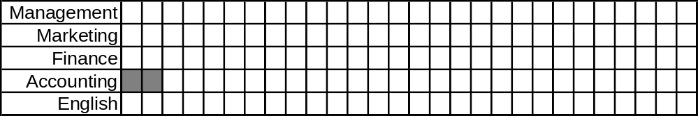
Shortest Processing Time (SPT)
Processing time:
9
3
8
2
6
Time until due:
23
15
18
6
8
Marketing
Finance
English
Management
Accounting

Slide 43
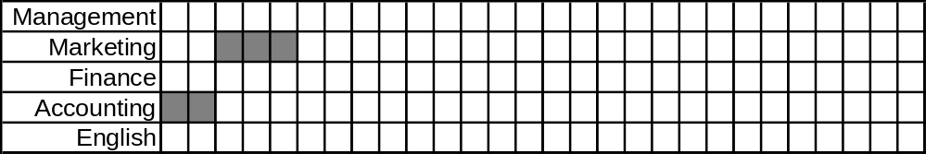
Shortest Processing Time (SPT)
Processing time:
9
3
8
2
6
Time until due:
23
15
18
6
8
Marketing
Finance
English
Management

Slide 44
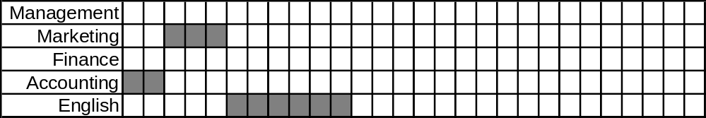
Shortest Processing Time (SPT)
Processing time:
9
3
8
2
6
Time until due:
23
15
18
6
8
Finance
English
Management

Slide 45
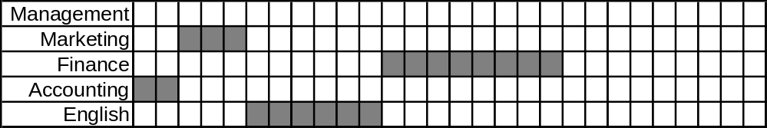
Shortest Processing Time (SPT)
Processing time:
9
3
8
2
6
Time until due:
23
15
18
6
8
Finance
Management

Slide 46
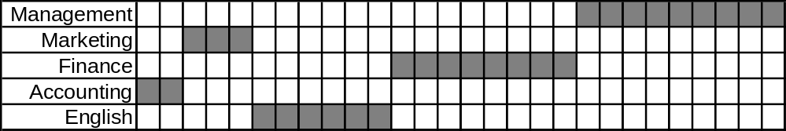
Shortest Processing Time (SPT)
Superimposing
due dates…
Processing time:
9
3
8
2
6
Time until due:
23
15
18
6
8
Management

Slide 47
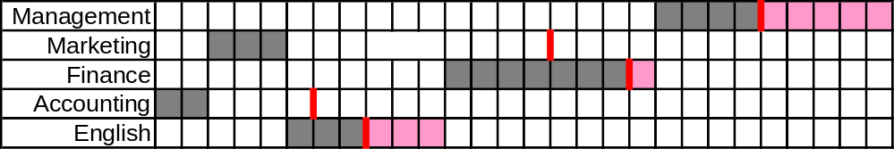
Shortest Processing Time (SPT)
Superimposing
due dates…
Total days late
Number of jobs
9
5
Avg. job lateness =
=
= 1.8 days
Processing time:
9
3
8
2
6
Time until due:
23
15
18
6
8

Slide 48
Shortest Processing Time (SPT)
Makespan =
28 days
Flow
time =
2
+
5
+
11
+
19
+
28
= 65
Average flow time =
65 days/5 jobs
= 13 days/job
Avg # jobs in system =
65 days/28 days
= 2.32
Utilization =
28 days/65 days
= 43.1%
Processing time:
9
3
8
2
6
Time until due:
23
15
18
6
8

Slide 49
Sequencing Rules (Single Resource)
Local
  First Come First Served
  Last Come First Served
  Shortest Processing Time
  Longest Processing Time
  Earliest Due Date
Global
  Slack Per Remaining Operation
  Critical Ratio

Slide 50
Longest Processing Time (LPT)
Process the job with the longest
processing time first
Processing time:
9
3
8
2
6
Time until due:
23
15
18
6
8
Marketing
Finance
English
Management
Accounting

Slide 51
Longest Processing Time (LPT)
Processing time:
9
3
8
2
6
Time until due:
23
15
18
6
8
Marketing
Finance
English
Management
Accounting

Slide 52
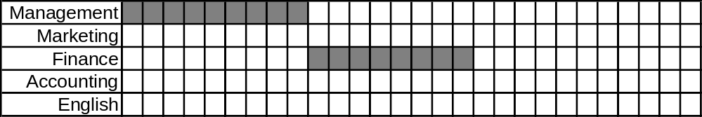
Longest Processing Time (LPT)
Processing time:
9
3
8
2
6
Time until due:
23
15
18
6
8
Marketing
Finance
English
Accounting

Slide 53
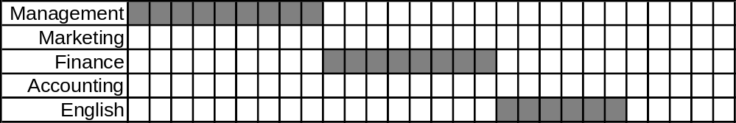
Longest Processing Time (LPT)
Processing time:
9
3
8
2
6
Time until due:
23
15
18
6
8
Marketing
English
Accounting

Slide 54
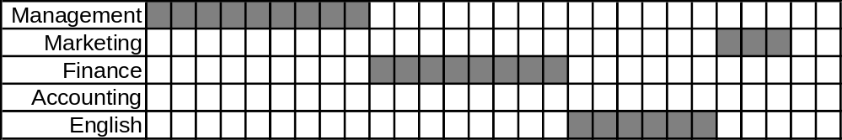
Longest Processing Time (LPT)
Processing time:
9
3
8
2
6
Time until due:
23
15
18
6
8
Marketing
Accounting

Slide 55
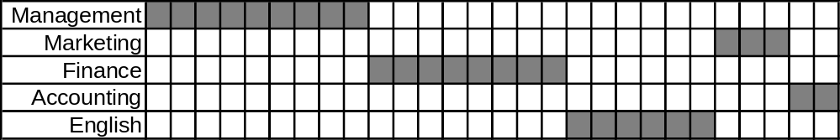
Longest Processing Time (LPT)
Superimposing
due dates…
Processing time:
9
3
8
2
6
Time until due:
23
15
18
6
8
Accounting

Slide 56
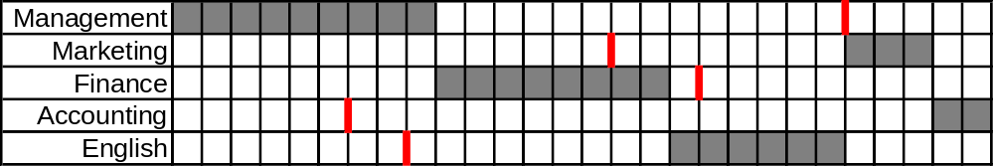
Longest Processing Time (LPT)
Superimposing
due dates…
Processing time:
9
3
8
2
6
Time until due:
23
15
18
6
8

Slide 57
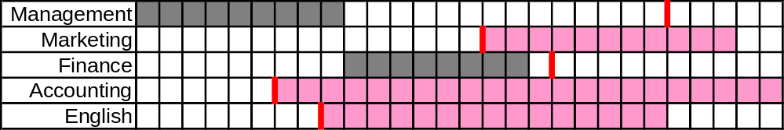
Longest Processing Time (LPT)
Total days late
Number of jobs
48
5
Avg. job lateness =
=
= 9.6 days
Processing time:
9
3
8
2
6
Time until due:
23
15
18
6
8

Slide 58
Longest Processing Time (LPT)
Makespan =
28 days
Flow time =
+
17
+
+
+
9
23
26
28
= 103
Average flow time =
103 days/5 jobs
= 20.6 days/job
Avg # jobs in system =
103 days/28 days
= 3.68
Utilization =
28 days/103 days
= 27.2%
Processing time:
9
3
8
2
6
Time until due:
23
15
18
6
8

Slide 59
Sequencing Rules (Single Resource)
Local
  First Come First Served
  Last Come First Served
  Shortest Processing Time
  Longest Processing Time
  Earliest Due Date
Global
  Slack Per Remaining Operation
  Critical Ratio

Slide 60
Earliest Due Date (EDD)
Process the job with the earliest due date first
Processing time:
9
3
8
2
6
Time until due:
23
15
18
6
8
Marketing
Finance
English
Management
Accounting

Slide 61
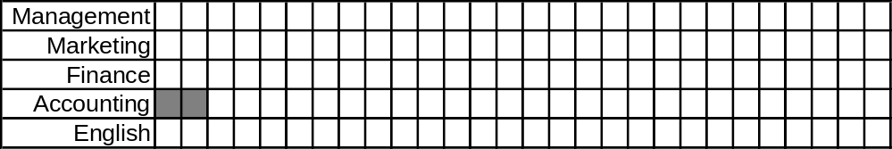
Earliest Due Date (EDD)
Processing time:
9
3
8
2
6
Time until due:
23
15
18
6
8
Marketing
Finance
English
Management
Accounting

Slide 62
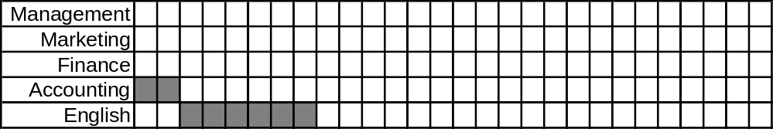
Earliest Due Date (EDD)
Processing time:
9
3
8
2
6
Time until due:
23
15
18
6
8
Marketing
Finance
English
Management

Slide 63
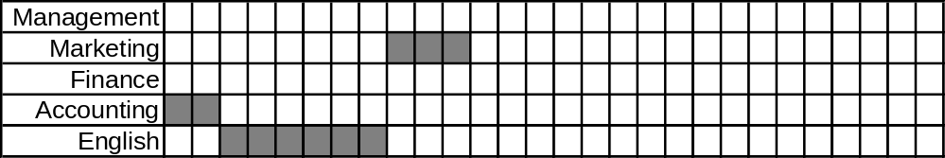
Earliest Due Date (EDD)
Processing time:
9
3
8
2
6
Time until due:
23
15
18
6
8
Marketing
Finance
Management

Slide 64
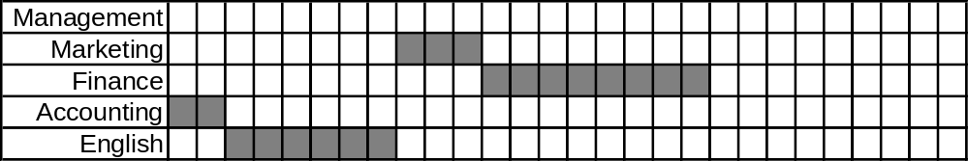
Earliest Due Date (EDD)
Processing time:
9
3
8
2
6
Time until due:
23
15
18
6
8
Finance
Management

Slide 65
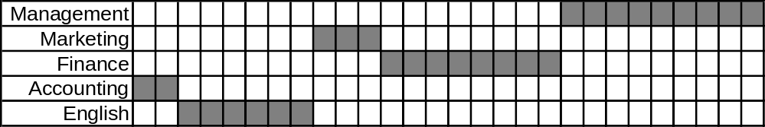
Earliest Due Date (EDD)
Superimposing
due dates…
Processing time:
9
3
8
2
6
Time until due:
23
15
18
6
8
Management

Slide 66
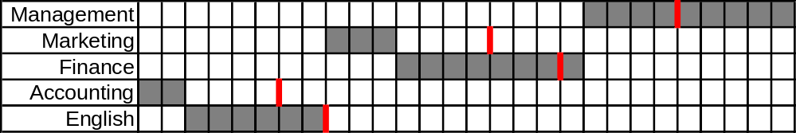
Earliest Due Date (EDD)
Superimposing
due dates…
Processing time:
9
3
8
2
6
Time until due:
23
15
18
6
8

Slide 67
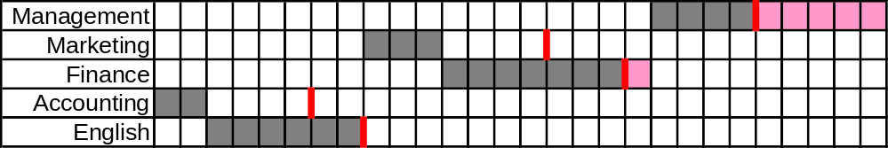
Earliest Due Date (EDD)
Superimposing
due dates…
Total days late
Number of jobs
6
5
Avg. job lateness =
=
= 1.2 days
Processing time:
9
3
8
2
6
Time until due:
23
15
18
6
8

Slide 68
Earliest Due Date (EDD)
Superimposing
due dates…
Makespan =
28 days
Flow
time =
2
+
8
+
11
+
19
+
28
= 68
Average flow time =
68 days/5 jobs
= 13.6 days/job
Avg # jobs in system =
68 days/28 days
= 2.43
Utilization =
28 days/68 days
= 41.2%
Processing time:
9
3
8
2
6
Time until due:
23
15
18
6
8

Slide 69
Summary
Avg lateness
Avg flowtime
Avg #jobs
utilization
FCFS
2.2
15.4
2.75
36.4%
LCFS
7.6
18.2
3.25
30.8%
SPT
1.8
13
2.32
43.1%
LPT
9.6
20.6
3.68
27.2%
EDD
1.2
13.6
2.43
41.2%
Notes:
17

